Slide 1






Major Project

Slide 2
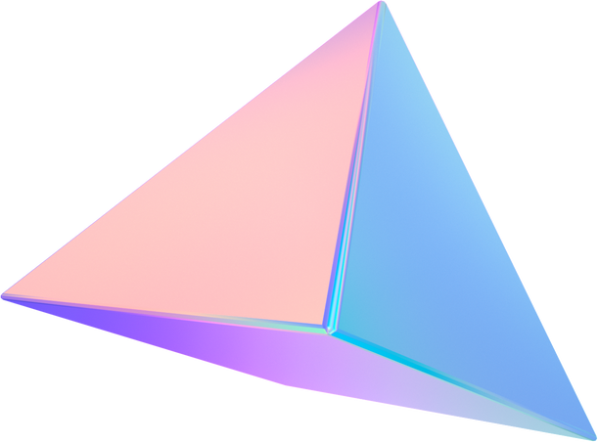

Introduction
Truffle is a culinary centric app whose aim is to provide a unique and immersive experience for food enthusiasts. It is an application where users can share and shapren their culinary skills and knowledge alongside bulding a community based on their inetrests
1

Slide 3

Why do we neet it?
Cooking is an essential skill that a majority lacks. This app is designed to make learning cooking fun,easy and more approachable for the customers.
2

Slide 4




Techonologies Used
Firebase
Formik
Reactnative
Yup
3

Slide 5
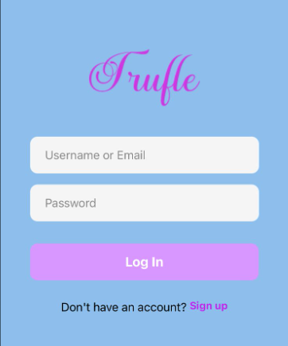


Features
LOG IN PAGE
A login page to enter the use credentials and access their accounts
4

Slide 6
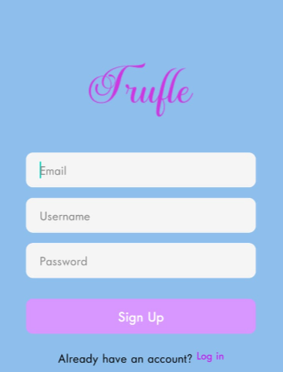
Features
SIGN UP PAGE
User can enter their email, prefered user name and their password to create an account on the application
5

Slide 7
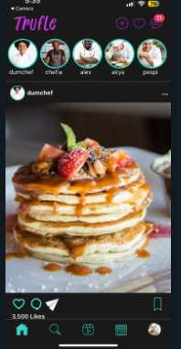
Features
Home Page
Where the user can view postsand stories curated to their liking and their following, alongside the options to like and upload stores as well as posts
6

Slide 8
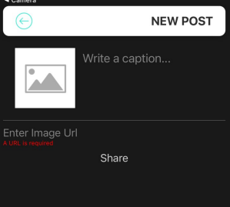
Features
Post Button
The user can upload posts by using the image’s URL and add any caption of their liking
7

Slide 9
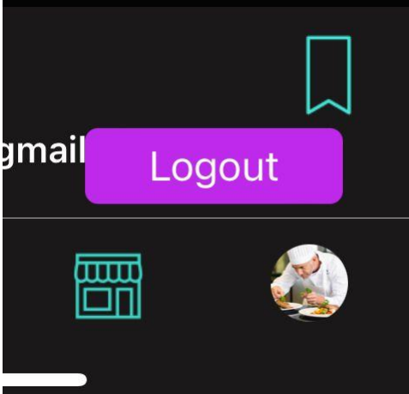
Features
Sign out
Long press on the profile photo present in the navigation bar have an easy sign out from the account

Slide 10

Thank You

